Slide 1


“Analytics on Career in STEM“
Team – Orange Dots .
Aditi Agrawal
Ankita Aggarwal
Priya Mishra

Slide 2



Notes:
What are you telling with your visualization? Past, Present, Future trends in STEM occupations in US

Slide 3



Notes:
Students are often confused about choosing career paths.
We asks friends and family, search on the internet, but end up with unsatisfactory answers.

Slide 4
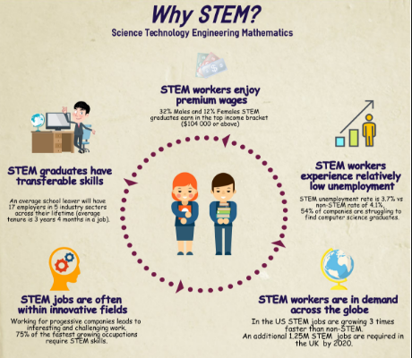
Why we chose STEM?
Notes:
To guide students - how it is a useful source of information for the aspiring minds to shape their future in right direction

Slide 5
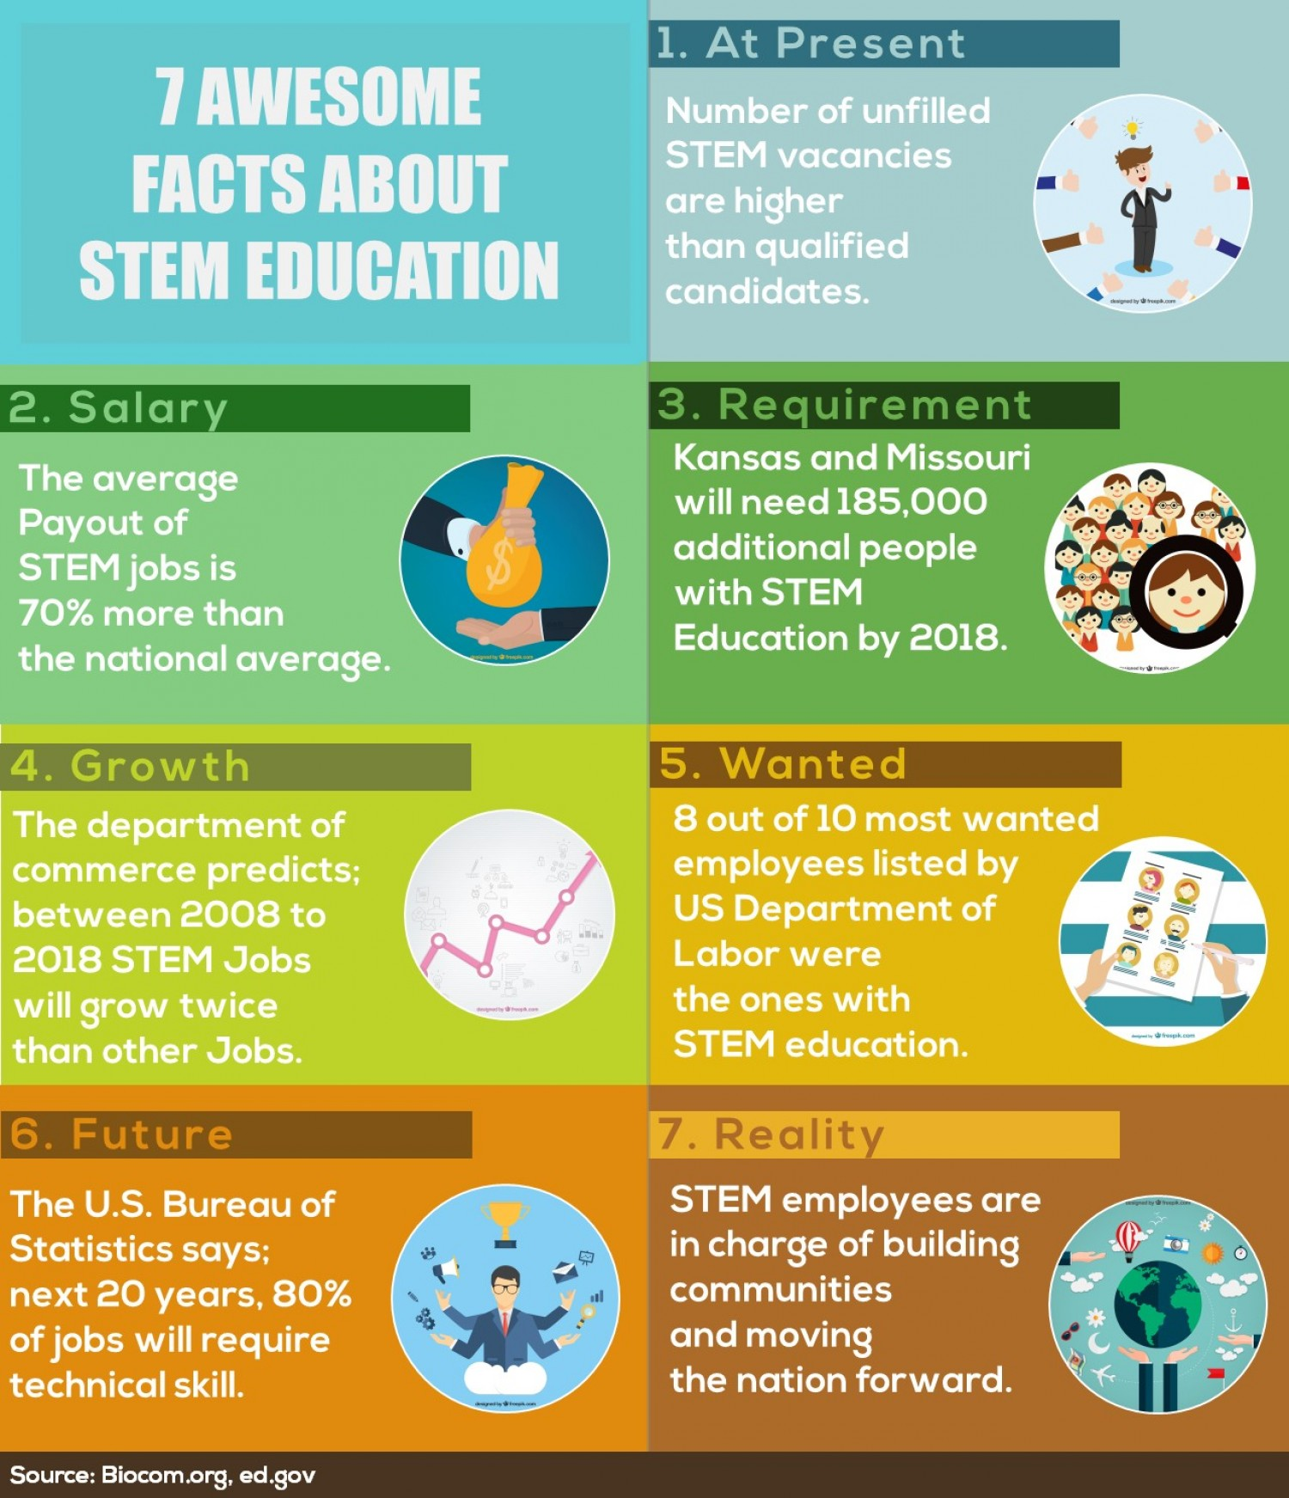
Why is it interesting?
Notes:
Why is it interesting?
Higher wages – helps decide students early which career path to choose, as this is quite rewarding
Job Growth – relatively low unemployment
STEM graduates have transferrable skills

Slide 6


Notes:
Target Audience – High school students who aspire to build career in STEM but confused to choose the correct path.
People seeking new start and switches

Slide 7


Notes:
How is your visualization useful?
- We are answering all dimensions involved in decision making in choosing a stem career pathway.

Slide 8
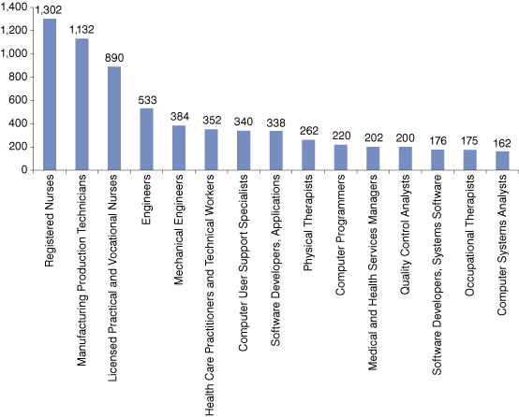
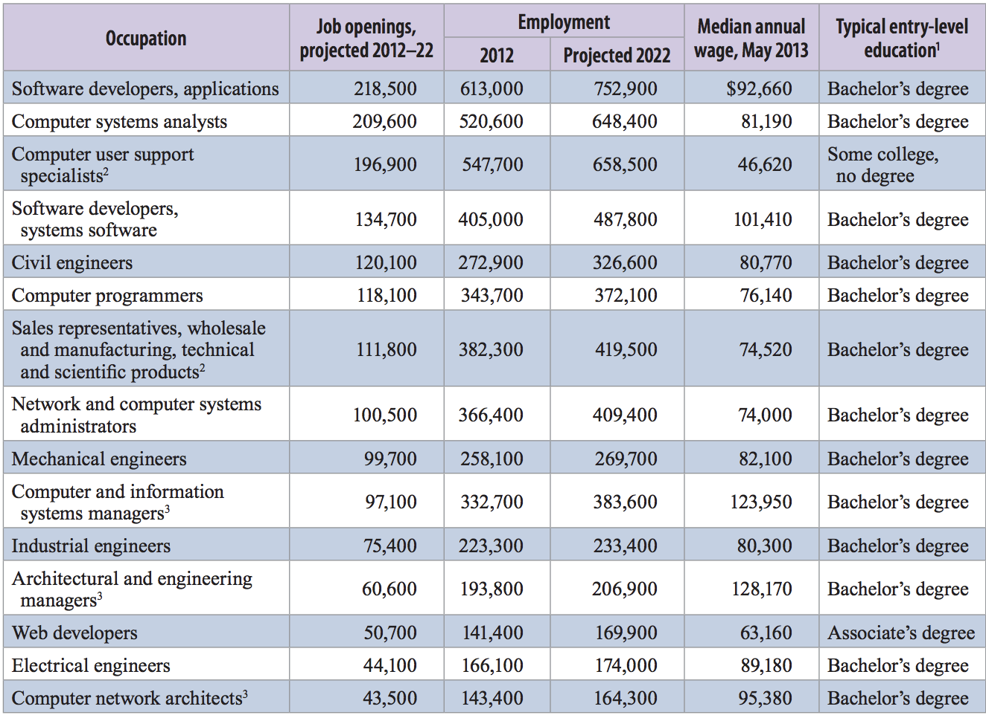
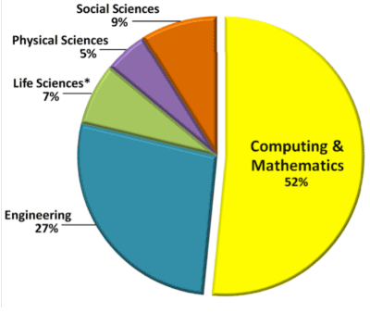
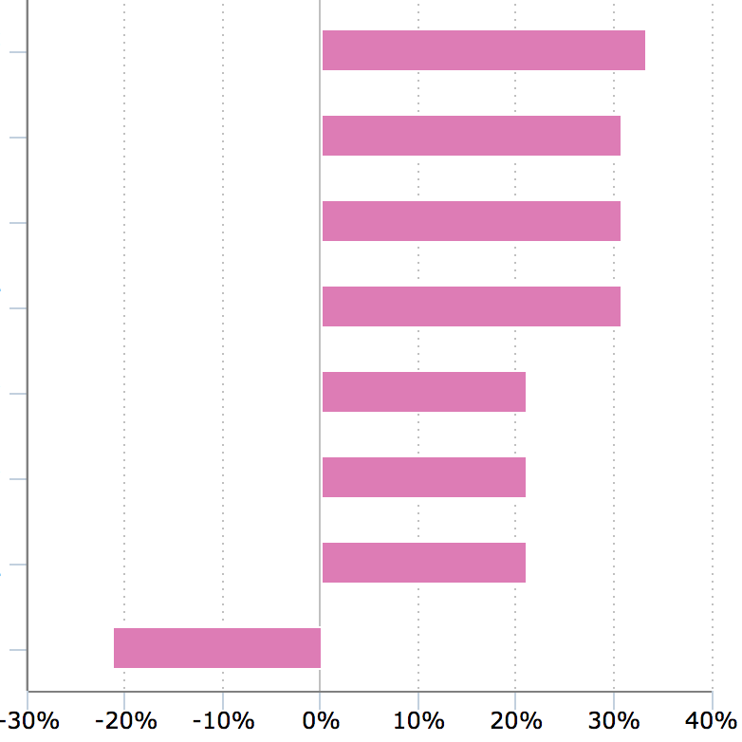
Notes:
Why is your visualization important? There is a neeeddddd for it. OBVIO!
Current STEM data is non interactive and uni-dimensional

Slide 9
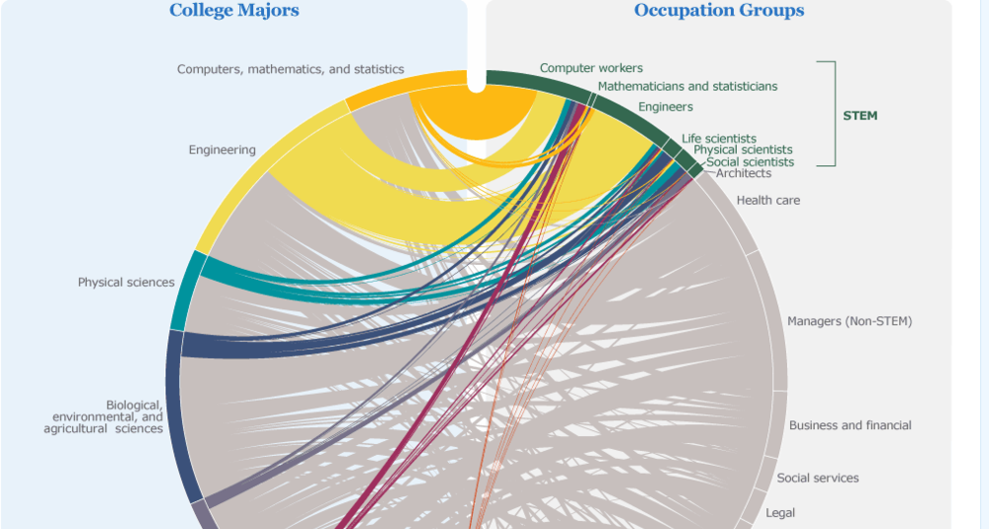
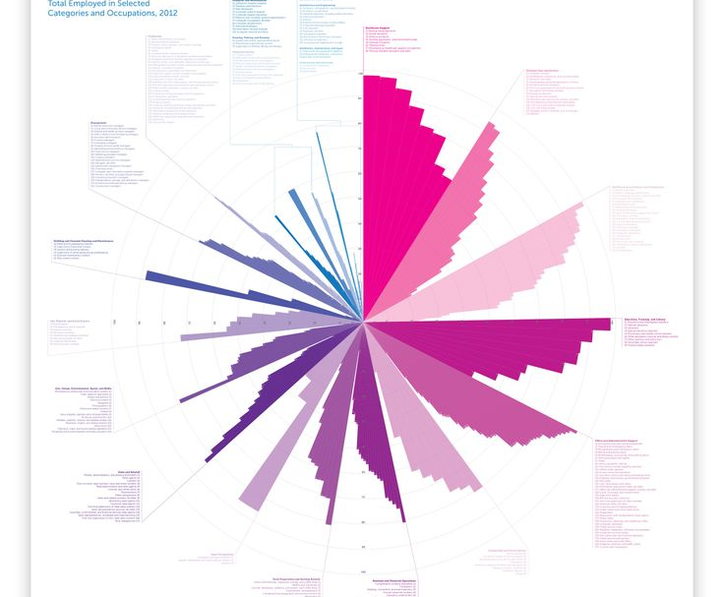

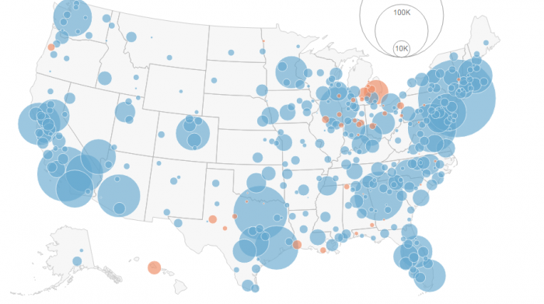
Notes:
What are you telling with your visualization? What is the story? Described above!!
We plan to make our Visualizations multi-dimensional, novel and easy to understand

Slide 10

Data Source
Notes:
Give our data about all existing occupations for the year 2012 – 2015. We apply our visualization techniques on a subset of this dataset

Slide 11
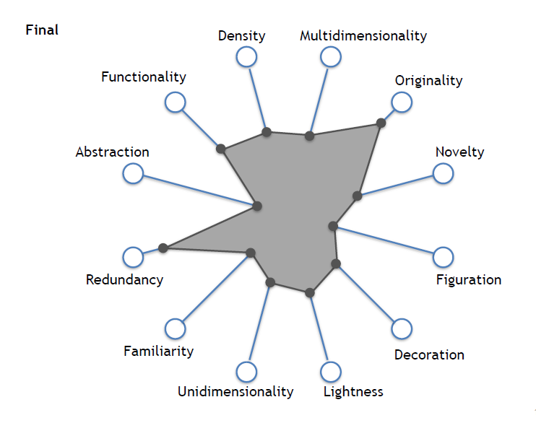
Design Consideration
Notes:
How do you plan to use interactive visuals?
What are your design considerations?
Visualization is presented clearly in an understandable manner, by avoiding any kind of cluttering.
Focus on the Cairo’s visualization wheel

Slide 12

Technologies we plan to use
Notes:
+ Data cleaning tool – like open Refine or R

Slide 13
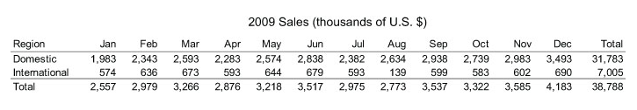
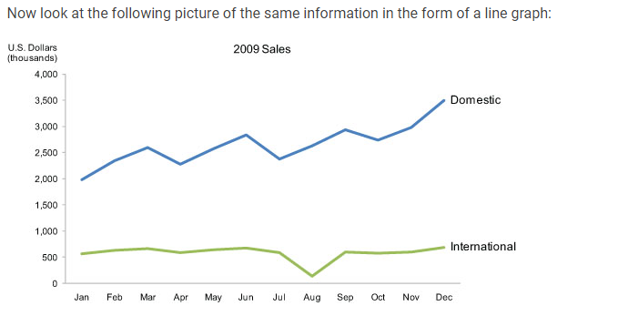
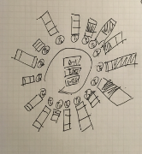
How to design, build and evaluate?
“A picture is worth a thousand words - but only when the story is best told graphically rather than verbally and the picture is well designed”.
Notes:
Design – A picture is worth a thousand words - but only when the story is best told graphically rather than verbally and the picture is well designed.
Choosing the best design that represents the data will be the key design strategy.
Figure 13.1
This table does two things extremely well: it expresses these sales values precisely and it provides an efficient means to look up values for a particular region and month. But if we're looking for patterns, trends, or exceptions among these values, if we want a quick sense of the story contained in these numbers, or we need to compare whole sets of numbers rather than just two at a time, this table fails.
Figure 13.2
Several facts now leap into view:
Domestic sales were considerably and consistently higher than international.
Domestic sales trended upward over the year as a whole.
International sales, in contrast, remained relatively flat, with one glaring exception: they decreased sharply in August.
Domestic sales exhibited a cyclical pattern - up, up, down - that repeated itself on a quarterly basis, always reaching the peak in the last month of the quarter and then declining dramatically in the first month of the next.
What these numbers could not communicate when presented as text in a table, which our brains interpret through the use of verbal processing, becomes visible and understandable when communicated visually. This is the power of "data visualization."
https://www.interaction-design.org/literature/book/the-encyclopedia-of-human-computer-interaction-2nd-ed/data-visualization-for-human-perception

Slide 14
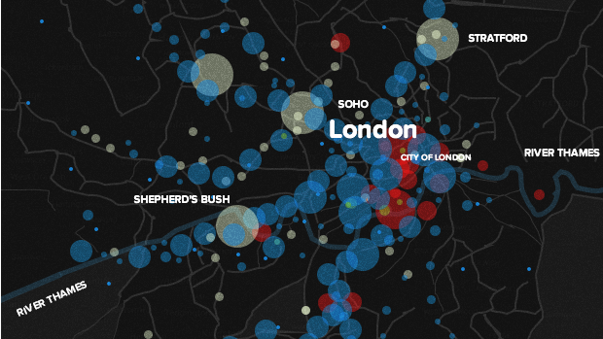
using D3 to build beautiful web maps
Notes:
Design goal : Create an experience which allows users to be able to play around and explore the employment statisitcs and dig out meaningful information that best suits their interest.

Slide 15
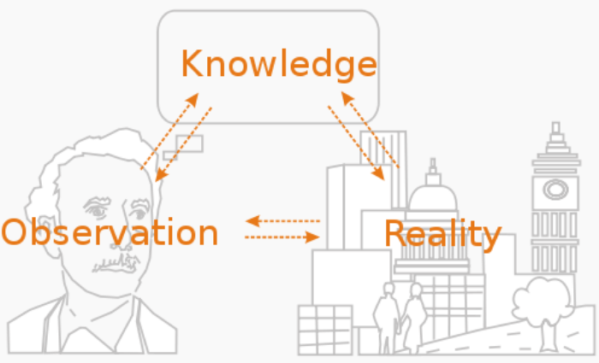
Evaluate
Notes:
Evaluation methodologies:
Observation
Focus Groups – evaluation team
Controlled experiments

Slide 16
14. Deliverables?
Notes:
- a fully interactive visualization project covering multiple coordinated views representing different aspects of Occupational Employment Statistics.
a fully functional prototype demonstrating key features,
and a process book documenting each steps as well.
Video
Website
White Paper

Slide 17

15. How do you work together?

Slide 18
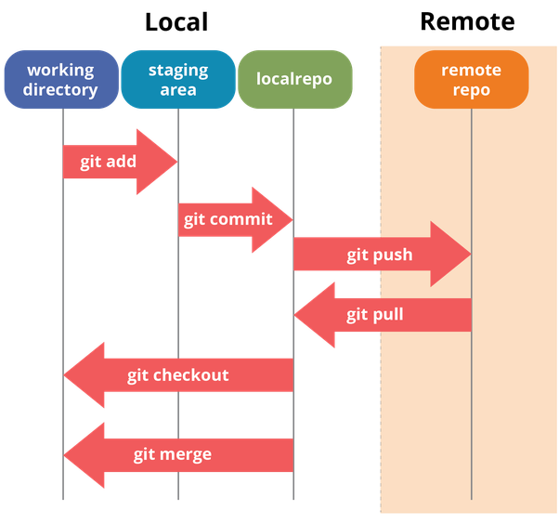

Notes:
Using git
Brainstorming sessions
Peer Reviews
Critique group involvement and reviews

Slide 19

Timeline

Slide 20
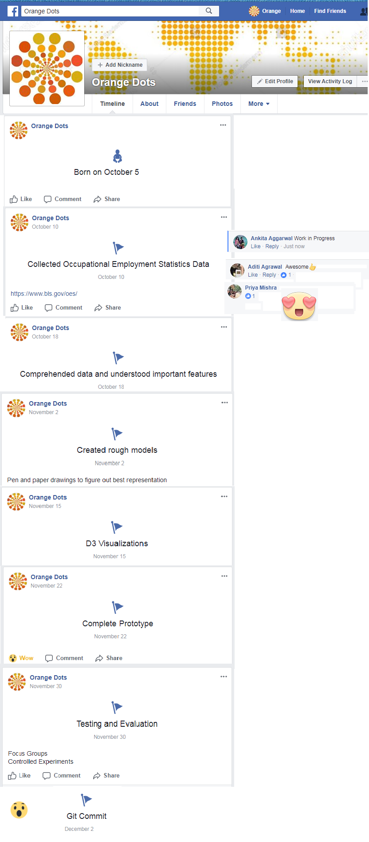
Notes:
https://github.com/INF554Fall17/a7-orange-dots/blob/master/orange%20dots%20timeline.png

